Slide 1
Lesson 13 - Animation
Mr Mack 2019

Slide 2
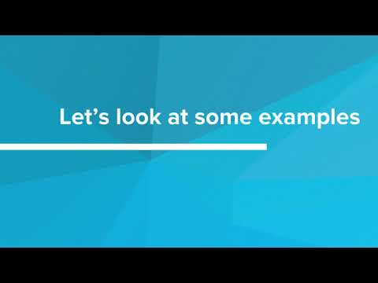
Animation

Slide 3
Which of the following defines an animation increase-font that increases the font size from 5px to 20px?
animation increase-font {
from {font-size: 5px;}
to {font-size: 20px;}
}
@keyframes increase-font {
font-size: {5px, 20px};
}
@keyframes increase-font {
from {font-size: 5px;}
to {font-size: 20px;}
}
@animation increase-font {
font-size: {5px, 20px};
}

Slide 4
Which of the following applies an animation named grayscaleFilter over 10 seconds to every img tag?
img {
animation-name: grayscaleFilter;
animation-length: 10s;
}
img {
animation: grayscaleFilter 10s;
}
img {
animation-name: grayscaleFilter;
animation-length: 10 seconds;
}
img {
animation: grayscaleFilter 10 seconds;
}

Slide 5
Example: Animated Image Filter
This is an example for this lesson. You are encouraged to play around with it, run and change the code, and learn how it works. When you are done, click continue to go to the next problem.

Slide 6
Exercise 4.13.1: Animated Invert Filter
In this exercise, you’ll add animation to the standard invert filter! Each color in the image will be inverted to it’s opposing color in the RGB spectrum, and the filter will be applied over time.
YOUR JOB
Create an animation that applies an invert filter to the image.
The image should start off normal (invert filter of 0%)
The image should end completely inverted (invert filter of 100%)
The entire animation should take 2 seconds
The image should remain inverted, it should not go back to normal after the animation is complete.

Slide 7
Exercise 4.13.2: Album Cover
Create an animated album cover for your awesome band.
Find a geometric picture. Put it on the webpage, and then add any animation filter you want to it.
Don’t forget the header to tell the user what your band name is.

Slide 8
Exercise 4.13.3: Aesop's Fables Part 3
Your Job
First, copy your code
Then, add a CSS animation to style.css called “open-book” that changes any book’s dimensions from a height of 200 px and a width of 100px to a height of 400px and a width of 300px.
Finally, add an animation attribute to the CSS rule you created previously so that the animation starts when you hover over a book. It should take 3 seconds, and keep its final state (so use forwards).
Some Hints
You will need to use @keyframes to define the animation
You will not need to create a new CSS rule. Add the animation attribute to a rule you already had.

